Slide 1
Big Data Project Hadoop, spark, and Hive
Akolom GEBREZGABHIER(ID#108229)
Maged Samaan (ID#984790)

Slide 2
Content
Hadoop Serialization
Pairs approach
Stripes approach
Hybrid approach
Spark
Hive

Slide 3
Time line
Hadoop Serialization – 2 minutes Maged
An approach – 3 minutes Maged
Approach Demo – 5 minutes Akolom
Spark & Demo – 5 minutes Akolom
Hive & Demo – 5 minutes Maged

Slide 4
Hadoop Serialization – Writable& WritableComparable
data needs to be transmitted between different nodes in a distributed computing environment. This requires serialization and deserialization.
Hadoop provides these writable wrappers for almost all Java primitive types.
We need to pass custom objects and these custom objects should implement Hadoop's Writable interface.
public interface Writable {
void readFields(DataInput in);
void write(DataOutput out);
}
WritableComparable
public interface WritableComparable extends Writable, Comparable{
void readFields(DataInput in);
void write(DataOutput out);
int compareTo(WritableComparable o)
}

Slide 5
Pairs approach
class Mapper
method Initialize
H = new AssociativeArray()
method Map(docid a; doc d)
for all term w in doc d do
for all term u in Neighbors(w) do
H{pair(w; u)} ← H{pair(w; u)} + 1
H{pair(w; *)} ← H{pair(w; *)} + 1
method Close
for all pair p in H do
Emit(pair p; count H{pair p})

Slide 6
Pairs approach
class Reducer
method Initialize
marginal = 0
method Reduce(pair p; counts[c1; c2; ...])
if (pair p == (w; *))
marginal = 0;
for all count c in counts[c1; c2; ...] do
marginal = marginal + c
else
sum = 0;
relativeFrequency = 0.0;
for all count c in counts[c1; c2; ...] do
sum = sum + c
relativeFrequency = sum / marginal
Emit(pair p; double relativeFrequency)

Slide 7
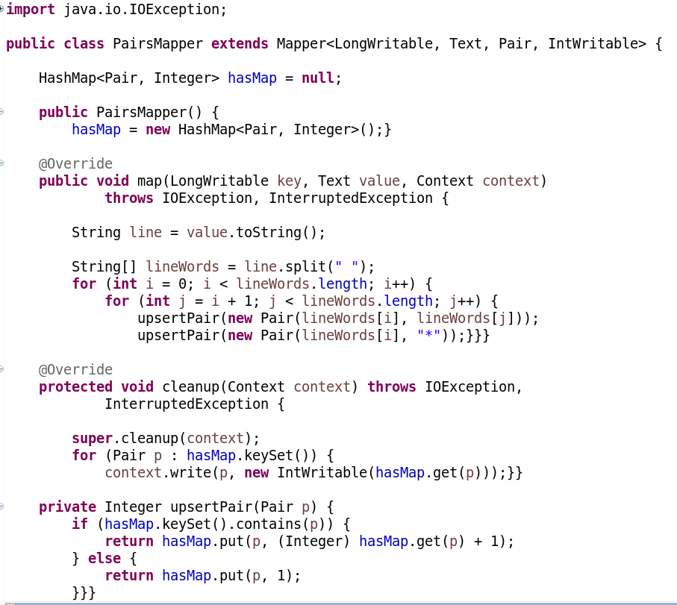
Pairs approach

Slide 8
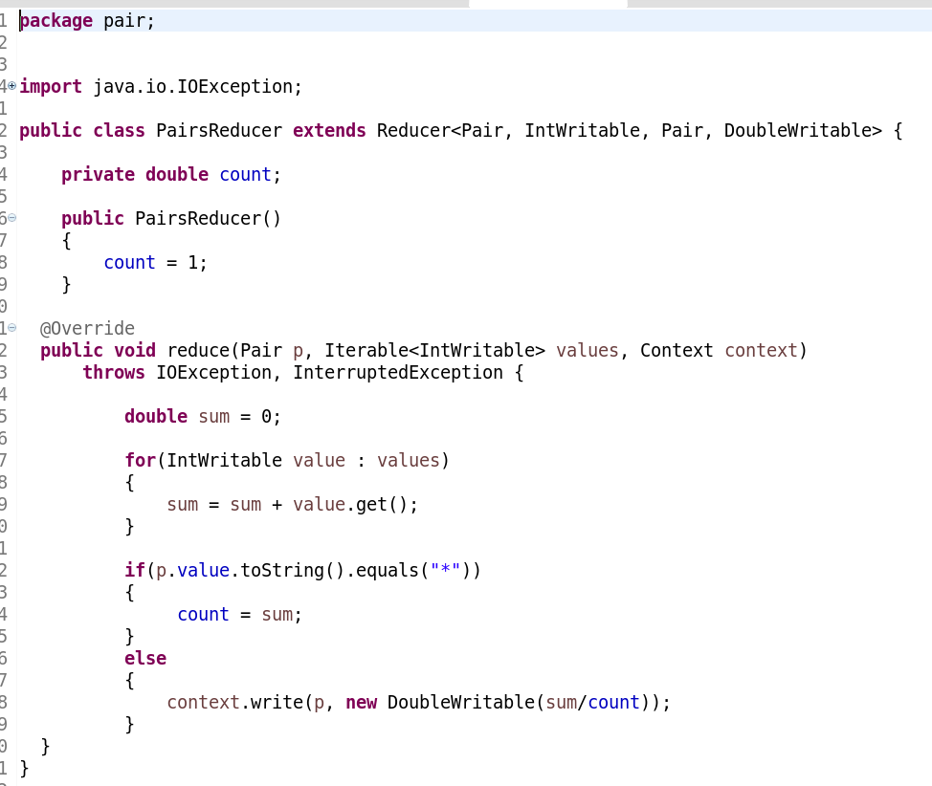
Pairs approach

Slide 9
Pairs approach
Output 1
422,435 1.0
425,450 0.3333333333333333
425,466 0.3333333333333333
425,471 0.3333333333333333
440,422 0.5
440,435 0.5
450,466 0.5
450,471 0.5
466,471 1.0
472,475 0.3333333333333333
472,522 0.3333333333333333
472,525 0.3333333333333333
Output 2
522,475 0.5
522,525 0.5
525,475 1.0
545,422 0.16666666666666666
545,435 0.16666666666666666
545,440 0.16666666666666666
545,475 0.16666666666666666
545,522 0.16666666666666666
545,525 0.16666666666666666

Slide 10
Stripes approach
Class Mapper
Method Map(docid a; doc d)
for all term w in doc d do
H = new AssociativeArray()
for all term u in Neighbors(w) do
H{u} = H{u} + 1
Emit(term w; stripe H)

Slide 11
Stripes approach
Class Reducer
Method Reduce(term w; stripes[H1;H2;H3; …])
Hf = new AssociativeArray()
marginal = 0
for all stripe H in stripes [H1;H2;H3; …] do
for all term u in H do
Hf{u} = Hf{u} + H{u}
marginal = marginal + H{u}
for all term u in Hf do
Hf{u} ← Hf{u} / marginal
Emit(term w; stripe Hf)

Slide 12
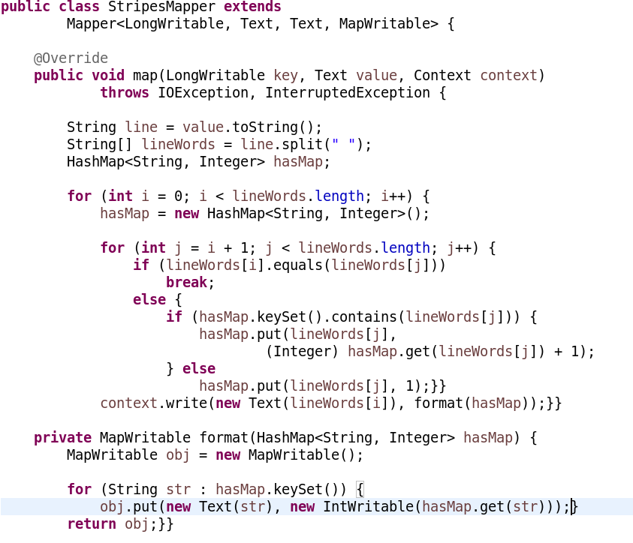
Stripes approach

Slide 13
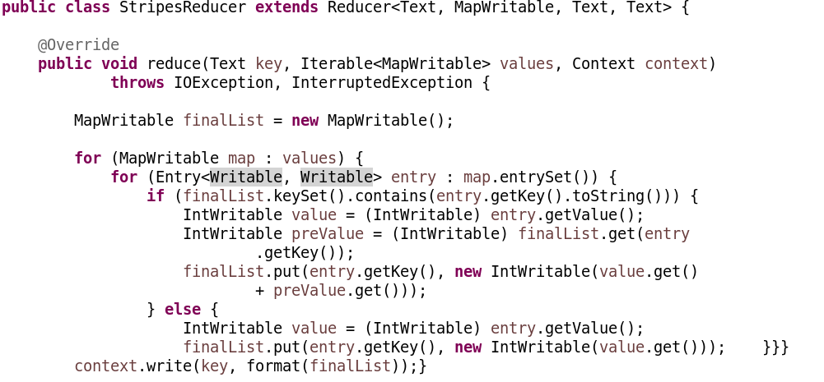
Stripes approach

Slide 14
Stripes approach
Output 1
422 [(435,1.0)]
425 [(450,0.3333333333333333) (471,0.3333333333333333) (466,0.3333333333333333)]
435 []
440 [(435,0.5)(422,0.5)]
450 [(471,0.5)(466,0.5)]
466 [(471,1.0)]
471 []
472 [(525,0.3333333333333333) (475,0.3333333333333333) (522,0.3333333333333333)]
475 []
Output 2
522 [(525,0.5)(475,0.5)]
525 [(475,1.0)]
545 [(440,0.16666666666666666) (435,0.16666666666666666) (422,0.16666666666666666) (525,0.16666666666666666) (475,0.16666666666666666) (522,0.16666666666666666)]

Slide 15
Hybrid approach
Class Mapper
method Initialize
H = new AssociativeArray()
method Map(docid a; doc d)
for all term w in doc d do
for all term u in neighbor(w) do
H{pair(w; u)} ← H{pair(w; u)} + 1
method Close
for all pair p in H do
Emit(pair p; count H{pair p})

Slide 16
Hybrid approach
Class Reducer
method inititalize
marginal = 0;
H = new AssociativeArray()
currentTerm= null;
method Close
for all term u in H do
H{u} = H{u} / marginal
Emit(term currentTerm, stripe H)

Slide 17
Hybrid approach
method Reduce(pair(w; u); counts[c1;c2; …])
if (currentTerm == null) then
currentTerm = w;
else if (currentTerm != w) then
for all term u in H do
H{u} = H{u} / marginal
Emit(term currentTerm, stripe H)
marginal = 0;
H = new AssociativeArray()
currentTerm = w;
for all count c in counts[c1;c2; …] do
H{u} = H{u} + c
marginal = marginal + c

Slide 18
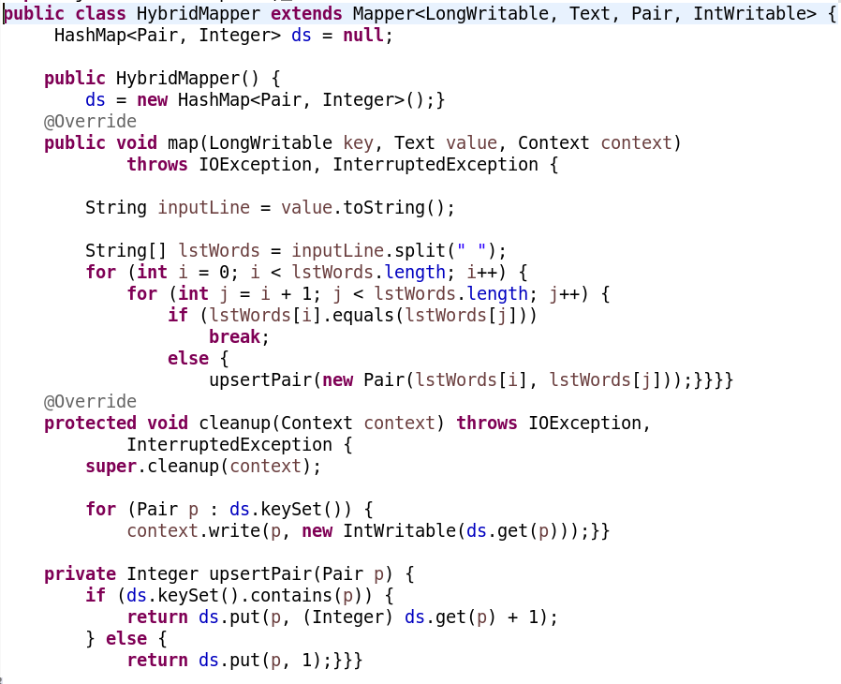
Hybrid approach

Slide 19
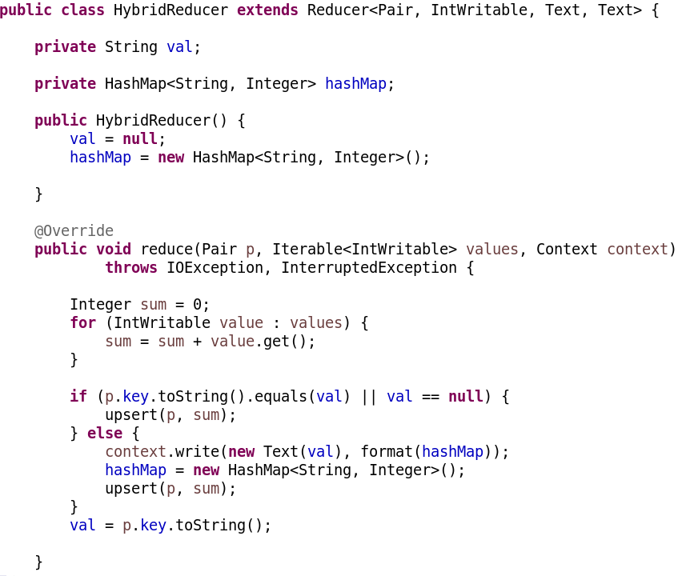
Hybrid approach

Slide 20
Hybrid approach
Output 1
422 [(435,1.0)]
425 [(450,0.3333333333333333) (471,0.3333333333333333) (466,0.3333333333333333)]
435 []
440 [(435,0.5)(422,0.5)]
450 [(471,0.5)(466,0.5)]
466 [(471,1.0)]
471 []
472 [(525,0.3333333333333333) (475,0.3333333333333333) (522,0.3333333333333333)]
475 []
Output 2
522 [(525,0.5)(475,0.5)]
525 [(475,1.0)]
545 [(440,0.16666666666666666) (435,0.16666666666666666) (422,0.16666666666666666) (525,0.16666666666666666) (475,0.16666666666666666) (522,0.16666666666666666)]

Slide 21
When to use what approach?
Pairs | Stripes | Hybrid
It can be used with any amount of memory | If the data is huge, this approach might not be usable. | For the mapper, any amount of is applicable but for the reducer, memory will limit its usage.
Slow, as a lot of data will be transmitted between nodes | No data duplication in the same node, so it will be faster as the amount of data transmitted is less. | You can use this when you need to make balance between speed and memory size.
Relative frequency is costly, mapper output will be x2. for the reducer, more processing and memory is needed. | Faster for relative frequency, no additional data is emitted in the mapper, and the processing in reducer is not much. | Good performance as the data in mapper is not duplicated as Paris, and it uses less memory than stripes in the reducer.

Slide 22
What is Apache Spark ?
You can use Spark by writing your code in Python, Scala or Java.
HDFS - Friendly
If you have HDFS file spark apache use directly or immediately without switch to another file. That means spark apache support HDFS.
supports real-time (stream) processing, Graphic analytics, machine learning and SQL.
Speed: 100 times faster than Map Reduce (in memory) and 10 times in disk.
Supports Batch, Interactive.

Slide 23
Transformations And Actions
Transformations are operations (such as map, filter, join, union, and so on) that are performed on an RDD and which yield a new RDD containing the result. Some transformations uses in our project is:
The mapToPair() method iterates over every element in the RDD and executes a PairFunction on the element. The PairFunction implements a call() method that accepts an input String (the word from the previous step) and returns a Tuple2 instance.
Actions are operations (such as reduce, count, first, and so on) that return a value after running a computation on an RDD.

Slide 24
Popular methods for transformation
map() applies a function to each element in the RDD and returns an RDD of the result.
flatMap() is similar to a map() in that it applies a function individually to each element in the RDD. But rather than returning a single element it returns an iterator with the return values. Spark then flattens the iterators of return values into one large result.
filter() returns an RDD that contains only those elements that match the specified filter criteria.
distinct() returns an RDD with only distinct or unique elements - it removes any duplicates.
union() is executed on an RDD in order to return a new RDD that contains the union(set operation) of it and another RDD. The result contains all elements from both RDDs.
intersection() returns an RDD that contains the intersection between two RDDs. The result contains only those elements that are in both RDDs.
subtract() removes the elements that are in one RDD from another RDD.
cartesian() computes the Cartesian product between two RDDs; note that this transformation should be used very cautiously because the result could consume a lot of memory!

Slide 25
Overview of the project
In this project we tried to analyze logs collected from an online shopping games and movies website
We processed the log files using spark and we came out with the following outputs:
Top Five users by the amount of time they spent visiting the website.
And much more analysis can be done on demand.
We have 3 classes namely UserSummarize, User, Functions

Slide 26
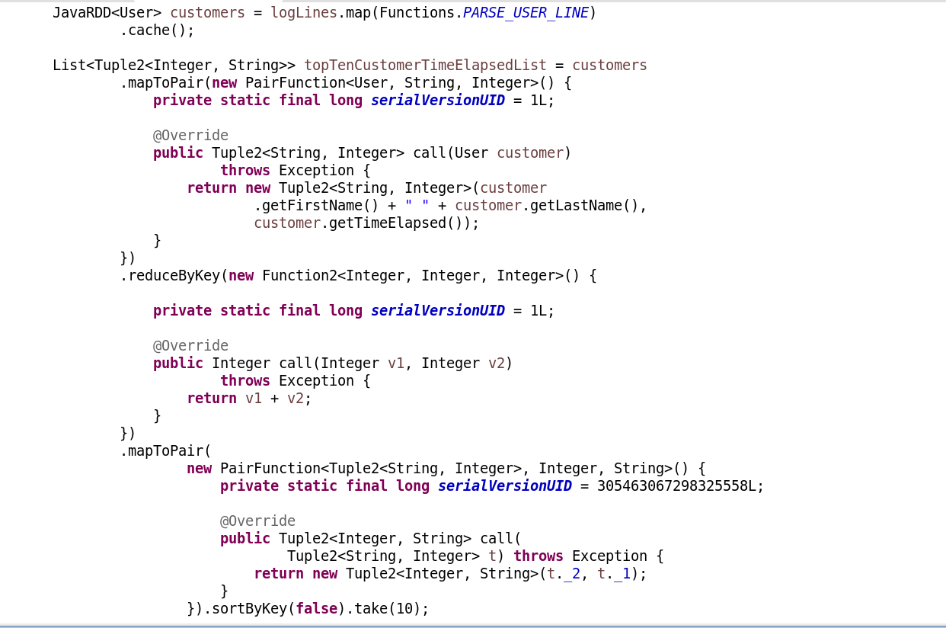
UserSummarize

Slide 27
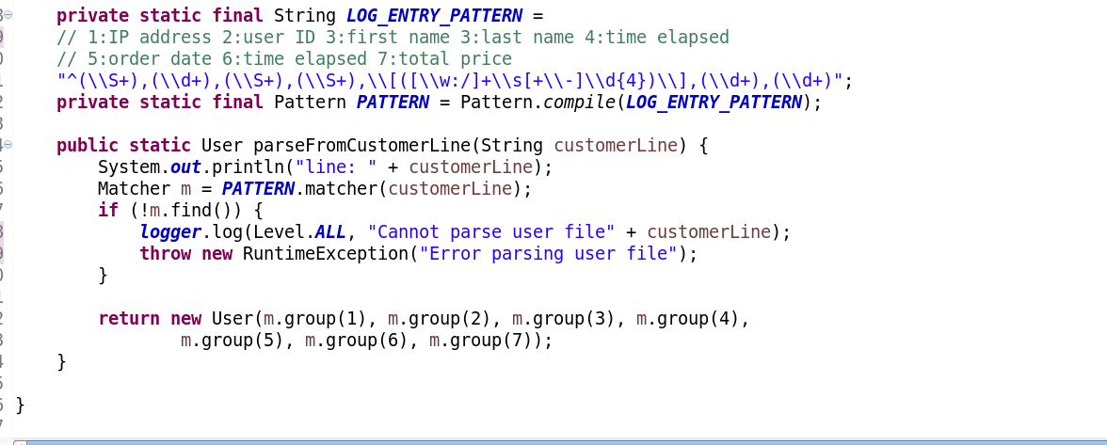
User

Slide 28
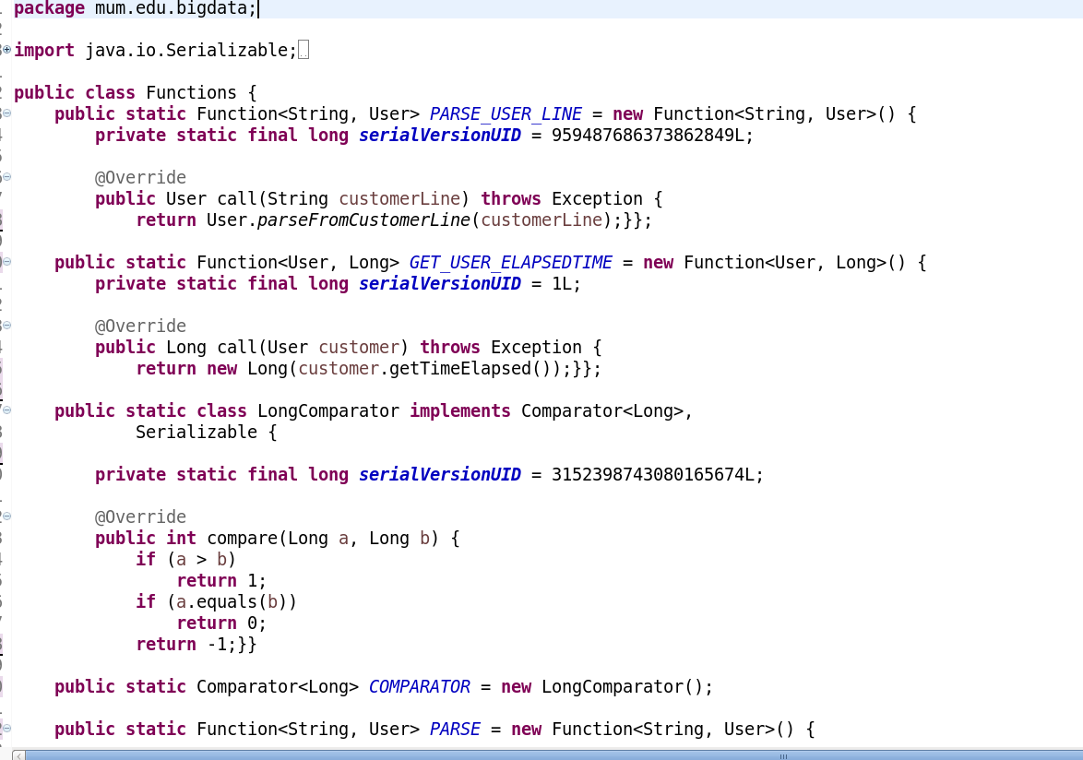
Function class

Slide 29
Top 5 Time Elapsed Users :
Top 5 Time Elapsed Customers :
(Nick Manaj, 1715)
(Sarah lewerence, 905)
(Tran Neviel, 905)
(Tyson Micheal, 700)
(Nigeria Yakin, 700)

Slide 30
What is the purpose of this project
After analyze top 5 users visiting a website, now you can show better suggestion to your website’s visitors.
This analyze helps to know which area is more users available.
This data analyze helps to some companies to introduce an advertisement to the website

Slide 31
Hive – what should you know about hive?
Apache Hive is a data warehouse infrastructure built on top of Hadoop for providing data summarization, query, and analysis.
Although it manages data in a fashion similar to RDBMSs, it's actually not a RDBMS. The underlying storage mechanism is still HDFS files.
You can use HiveQL (HQL), Similar to SQL, so any one familiar with SQL can take advantage of using Hadoop and HDFS.
Moreover when you issue a Hive query to fetch results, the query first gets converted into a MR job and then produces the result resulting in slow response, can we use HBase?
Along with that you can even map your existing HBase tables to Hive and operate on them
Note: we will use the console to do all our work. And we will use hive to store the input data.

Slide 32
Hive – When to use Hive? Why not HBase?!
Your team are already SQL ninjas.
If you have data to be aggregated, rolled up, analyzed across rows then consider Hive.
If you select full table scan - use hive. If index access – Hbase.

Slide 33
Hive - Demo
And add the below commands to a file and call it script.hql
create database BigDataDB;
use bigdatadb;
create table input (subject1 String, subject2 String,
subject3 String, subject4 String)
ROW FORMAT DELIMITED FIELDS TERMINATED BY ' ';
LOAD DATA LOCAL INPATH 'input.txt' INTO TABLE input;
select * from input;
Then run the command below
[cloudera@quickstart ~]$ hive -f script.hql

Slide 34
Thank you

